Slide 1
A Quick Intro to SparkR:
Experiences, Insights &
War Stories
Part 1: Quick Spark Overview
Part 2: Intro to Spark R
Part 3: Live Demo (with luck)?

Slide 2

Part 1: Quick Spark Overview

Slide 3

What is Apache Spark?
Open Source, developed at UC Berkeley.
Useful for large data sets.
Considered to be replacement to Hadoop Map Reduce.
Not quite true – everyone still uses HDFS and for batch jobs Hadoop works just fine.
Faster computation than Hadoop MapReduce.
No costly write to disk:
Read RDD (we’ll get back to that!) to memory, perform all calculations , then write back data.

Slide 4

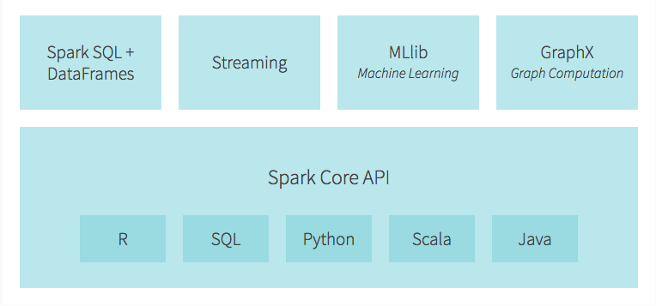
Apache Spark Ecosystem:
MLIib: MLib is Spark’s Machine Learning library. Consists of:
Classification
Regression
Clustering
GraphX: GraphX is a new component in Spark to simplify graph analytics tasks.

Slide 5
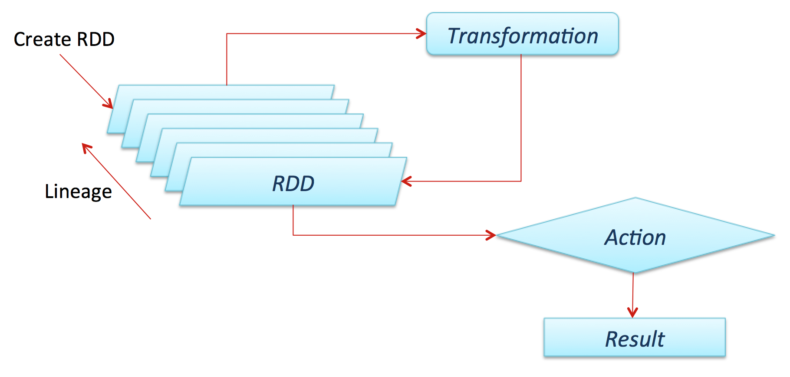
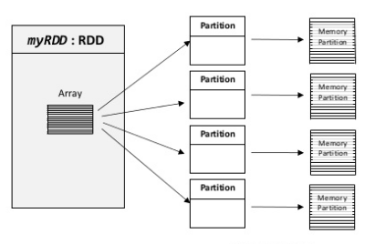
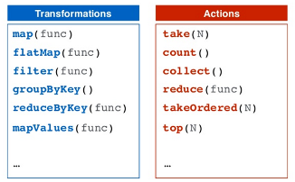
Spark: RDD Spark framework revolves around the concept of Resilient Distributed Datasets (RDD).
All You need to know to Start:
- Collection of elements that can be partitioned across the nodes of a cluster that are operated on in parallel.
Immutable
Only two types of operations: Transformations, Actions
- Lazy eval of transformations.

Slide 6
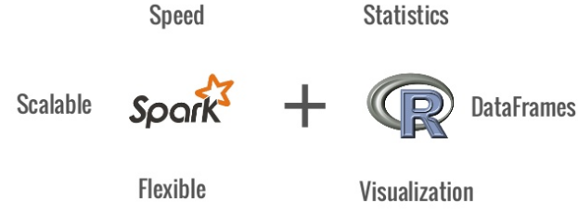
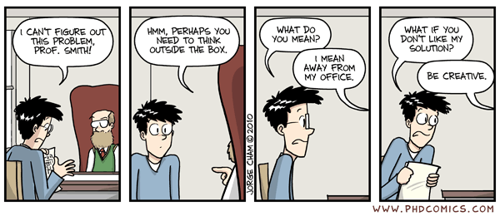
Part 2: Intro To SparkR

Slide 7

SparkR: An R package that provides a nice API
to the underlying Spark infrastructure.
Supports operations on large datasets
Selection, Filtering, Aggregation
SparkR also provides support for distributed machine learning using MLib.
Still quite early in the development. Expect some pain!

Slide 8
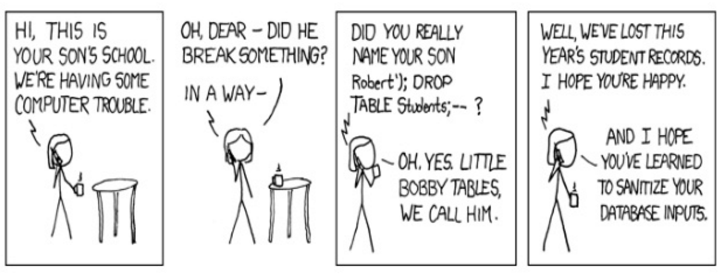
SparkR: Connecting R to Spark Cluster
SparkContext: Connecting the R program to the Spark cluster.
sc <- sparkR.init(with some magic parameters here)
SQLContext: Entry point for relational functionality in Spark.
SQLContext can be used to create DataFrames from RDD or from other data sources..
This is powerful: You can create a “DataFrame RDD” from a very many files and treat it as a “DF”.
SQLContext provides sql function enabling applications to run SQL queries.
sqlContext <- sparkRSQL.init(sc)
Connect to Spark cluster using:
RStudio
R Shell
RScript

Slide 9
Demo

Slide 10
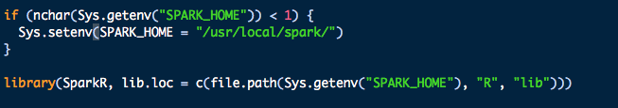
SparkR: Hands on Exercise Running SparkR on Rstudio
We must keep a track of the environment. SPARK_HOME is set in the environment.
Load the SparkR package and initiate. We can also specify our own specific Spark driver properties.

Slide 11

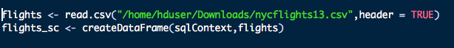
SparkR: Machine Learning Airline Example
Creating sparkContext
Reading the csv file
Creating dataframe for Spark
Notes:
1. Download the NYC flights dataset as a CSV from https://s3-us-west-2.amazonaws.com/sparkr-data/nycflights13.csv

Slide 12
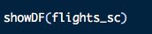
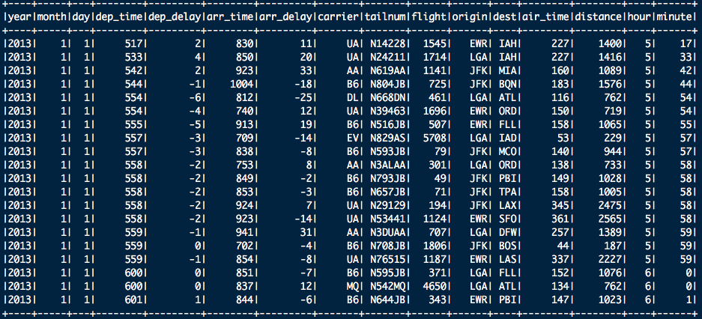
View the Dataframe using showDF()

Slide 13
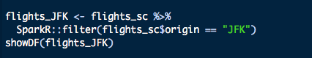
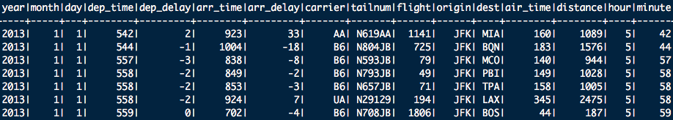
Filter:
Filtering the entries with origin as JFK

Slide 14
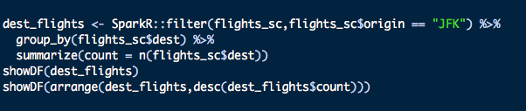
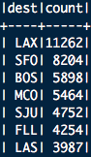
Group by:
Group the number of flights by destination and aggregating by the number of flights.

Slide 15
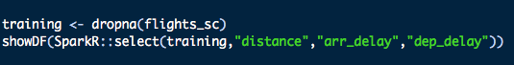
SparkR MLib: Machine Learning Fitting generalized linear model over dataframe using the glm() function using SparkR MLib. *Currently access to MLib in SparkR is still in development. Current support system includes Gaussian and Binomial families.
Gaussian Family:

Slide 16
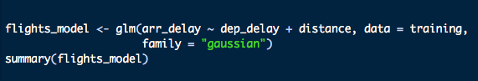
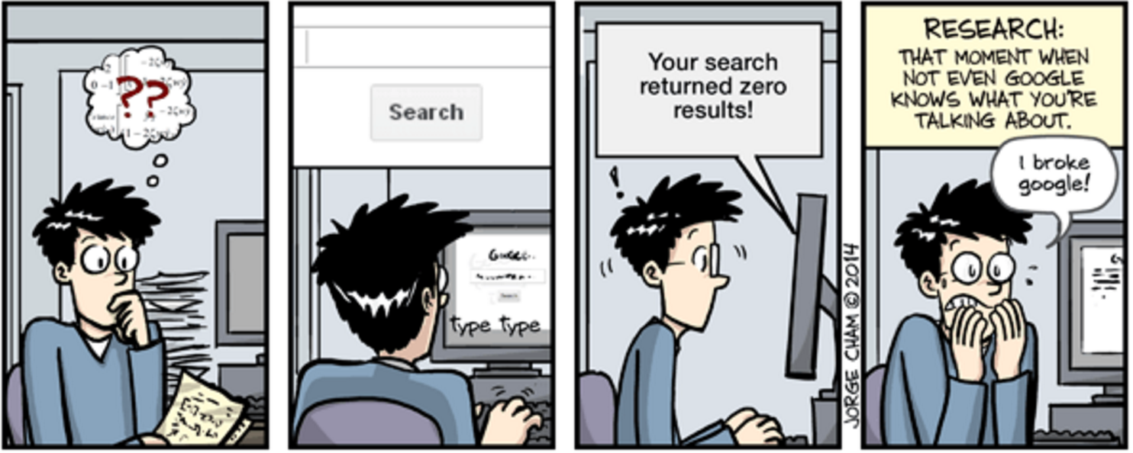
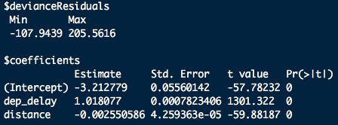
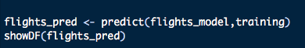
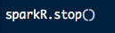
Fitting Gaussian Model:
Terminating the backend the R session is connected to:

Slide 17


Spark: Two common API’s For Data Scientists
Linear Model
Classification (SVM, Logistic Regression)
Linear Regression
Decision Trees
Ensembles of Decision Trees
Random Forest
Gradient-boosted trees
Naïve Bayes
DataFrame Operations
Selecting
Grouping
Filtering
Running SQL Queries
Machine Learning
Gaussian GLM model
Binomial GLM model
Still Catching up on Features

Slide 18





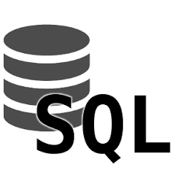





Getting & Cleaning The Data - longest part of the job
99% of the time, the data is:
Dirty
Incomplete
Very Large
In Different Places
1% of the time – you have an easy day!
Tools used in this step: Spark, SQL, Mongo, R, Python, HDFS, Spark + others

Slide 19

Getting & Cleaning The Data - longest part of the job
SparkR can be used in action in many ways.
Streaming ETL : Continuous cleaning and aggregation of data before pushing into data sources.
Data Enrichment : Live data is enriched with more information by joining it with a static
dataset allowing for a more complete real-time analysis.
Uber: ETL Pipeline
Collects terabytes of event data every day from their mobile users for real-time analytics.
Converts the raw unstructured event data into structured data as it is collected,
making it ready for further complex analytics.

Slide 20

Questions?

